Slide 1
Homecoming float construction safety orientation
Baylor University
2019
Ken O’Connor
Department of Environmental Health & Safety

Slide 2
General Recommendations
The float chairman must be responsible for the safety of the students working on the float
Use the buddy system…never work alone
In case of emergency call 9-1-1 (off campus)
If on campus, call 710-2222 (BU PD) for fastest response
If there is an accident resulting in injury, please let me know via Baylor’s online incident reporting system.
www.baylor.edu/ehs/

Slide 3
General Recommendations
NEVER assume people know how something works
Don’t let just anyone use powered equipment or welding/cutting equipment
Wear Proper Attire
No open shoes
No shorts
No synthetic fabrics
Long hair contained (ties back, hat, etc.)
Recommended Personal Protective Equipment (PPE)
Safety glasses, closed ended shoes, leather gloves
Have a First-Aid Kit on hand
Bandages, gauze, antiseptic ointments or sprays
If possible, always have injured person treat own injury
Sterile disposable gloves
Something to treat insect bites (ointments, sprays, Benadryl)
First aid burn cream

Slide 4
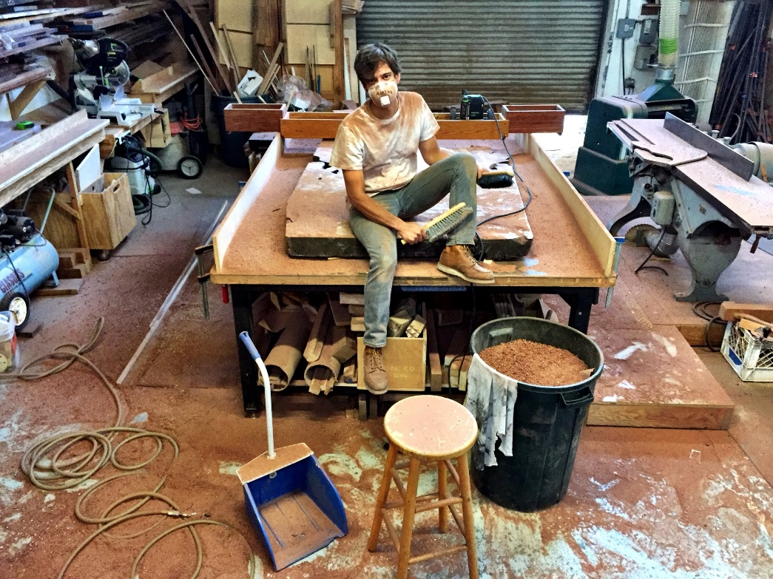
General Safety
Keep your construction area clean and organized.
Take ventilation of your site seriously, especially if using a gas powered generator, painting, or using solvents and paint thinners

Slide 5
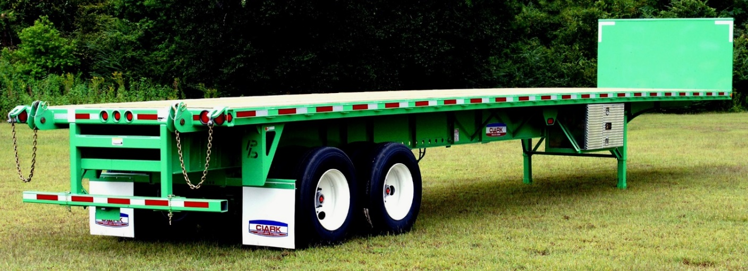
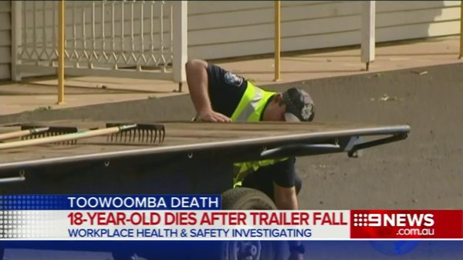
THE most important thing to address on day one of construction
How to Access to trailer bed
How do we build a float on this
Prevent this →

Slide 6
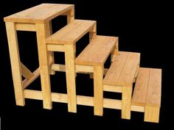
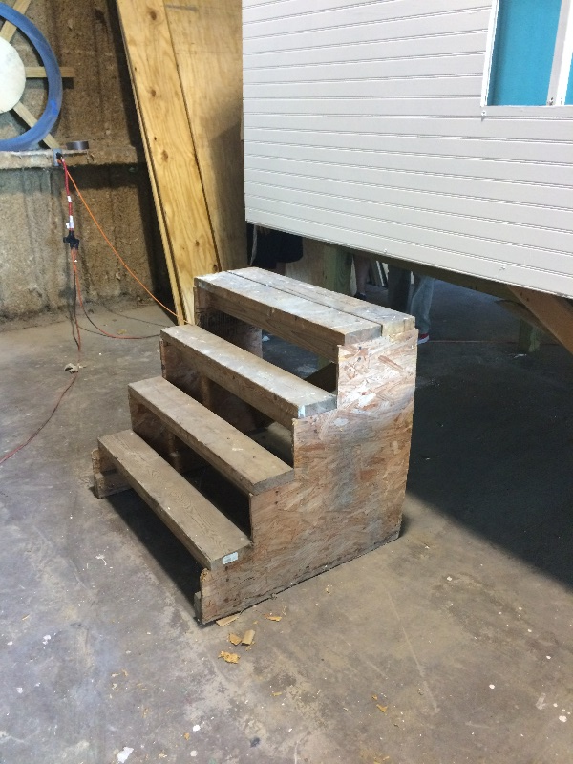
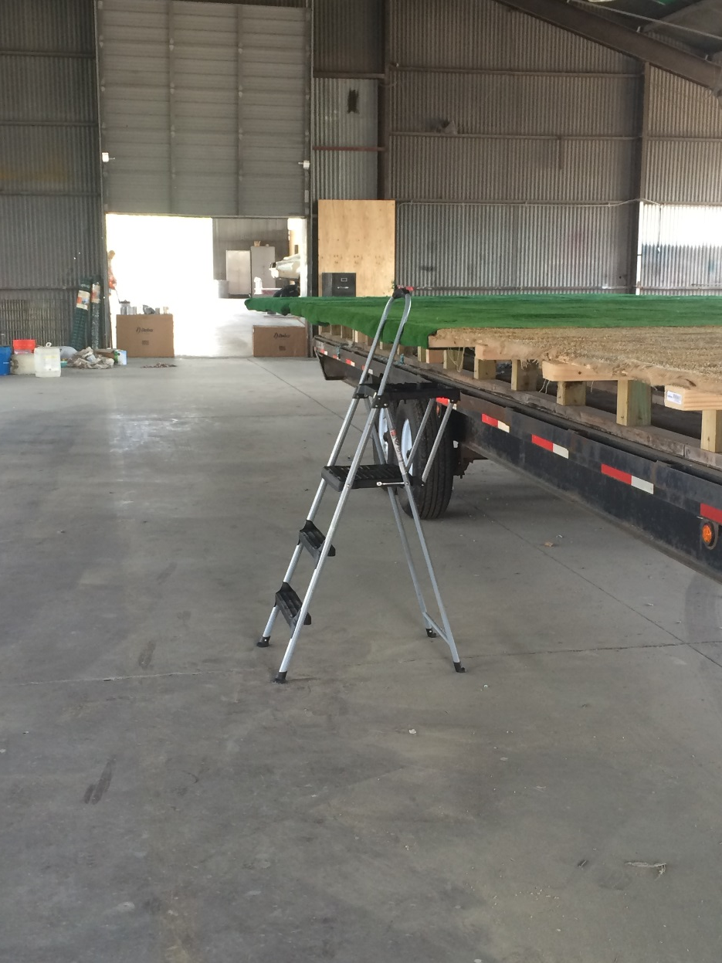
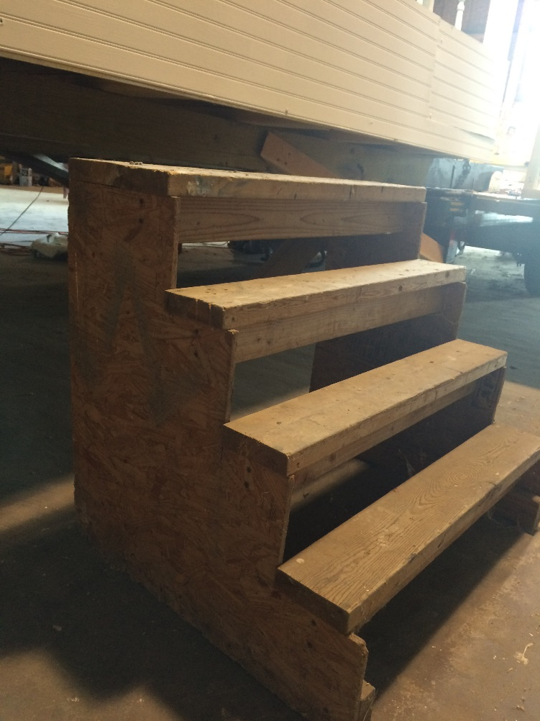
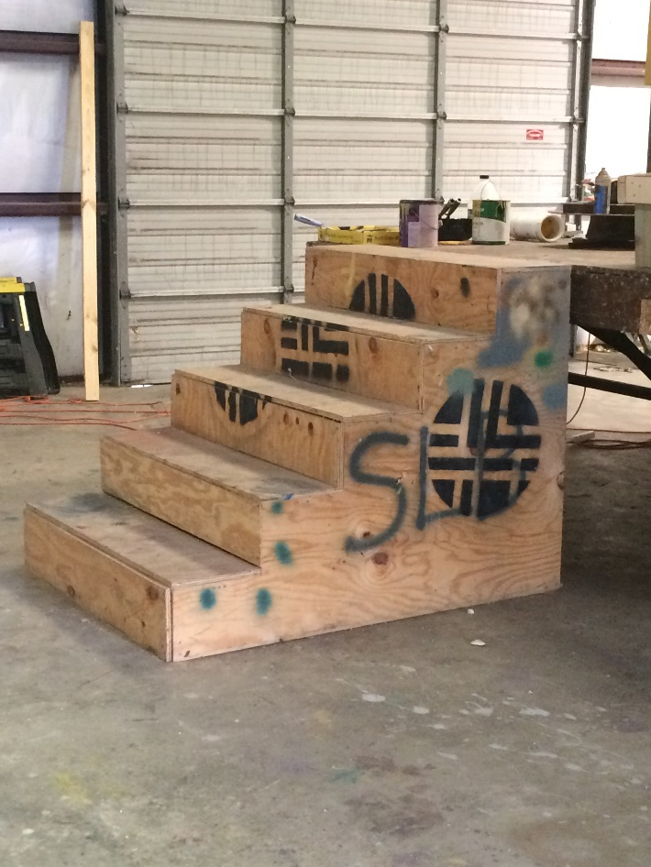

Slide 7
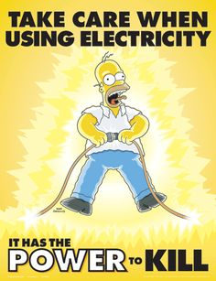
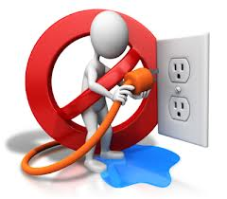
Electrical Safety
Reality Check:
Annually in US: 30,000 non-fatal shocks → 4400 required visit to emergency rooms → 400 required visit to morgue
The #1 cause of structure fires in the US.
Don’t use damaged or poor quality equipment, especially extension cords.
Do not mix water and electricity
Don’t overload the outlets
Typical receptacle is 15 A. A typical circular caw pulls 13.

Slide 8
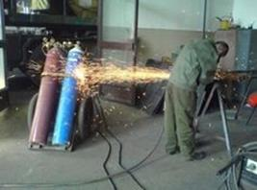
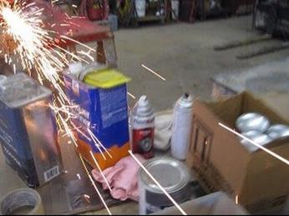
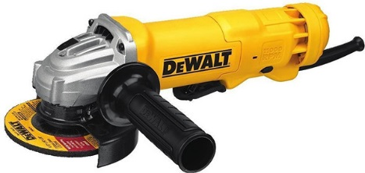
Angle Grinder
HAZARDS
Metal lodging in the eye (MOST COMMON)
Kickback can result in severe cuts to body and legs
Discs can shatter, sending pieces flying across workshop
Sparks can act as an ignition source
SAFE GUARDS
Wear goggles, or safety glasses+face shield
Use the correct type of disc (cutting versus grinding; different discs for different materials)
Make sure guards are in place and disc is undamaged
Remove flammables from work area

Slide 9
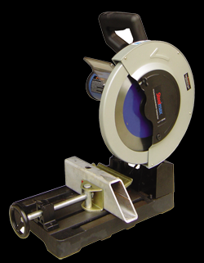
Circular Saw, Chop Saw, Miter Saws
HAZARDS
Eye injuries
Amputation
Safe Guards
Ensure guards are in place
Wear eye protection
Keep hands out of cutting zone. Even with guard in place, part of saw blade could be exposed.
Follow all recommendations in the OEM’s operating manual
Blade Guard

Slide 10
Welding and Cutting
Area assessment
Remove all combustible materials and flammable liquids within 35’.
Oily rags, saw dust, paper & cardboard
Flammable liquids should be kept in a fire cabinet, or as far back from ignition sources as possible.
Fire Protection
Need a minimum one 5 lb. ABC fire extinguisher
Fire watch (during welding and before leaving for the day)

Slide 11
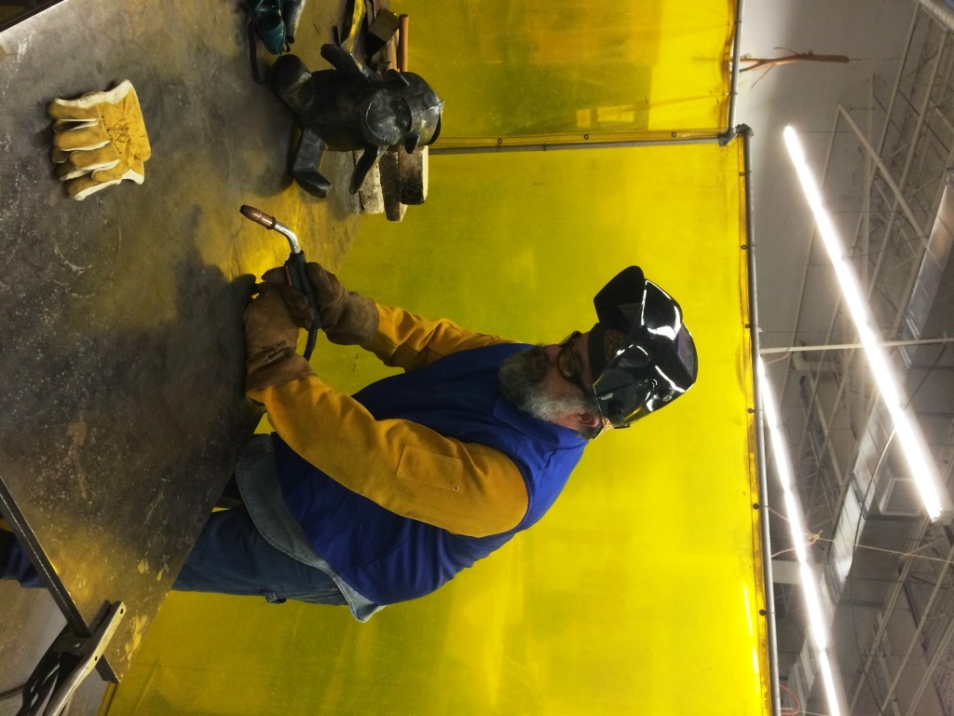
Welding - PPE
Welding helmet
Welding Curtain
Welding cap
Safety glasses
Welding jacket
Heavy denim pants
Welding gloves
Leather boots

Slide 12
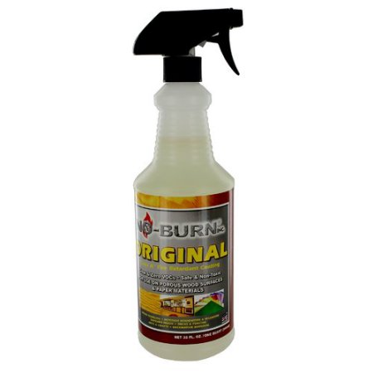
Float Inspection Schedule and Additional Recommendations
Inspection Schedule
One month out
One week out
Day prior
DC Batteries are preferred over gas powered generators
If using a generator, exhaust must be vented away from the float
Can not have any combustibles (pomping in particular) with in 12” of the vent pipe/hose
Fireproofing of pomping and other highly combustible materials is a requirement
UL Classified Class “A” Fire Retardant
Follow the directions for appropriate coverage and perform a few tests yourself
Questions??? Contact info:
KENNETH_OCONNOR@BAYLOR.EDU
254-709-7383 (C)

