Slide 1
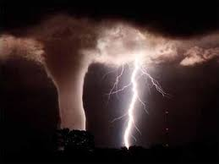
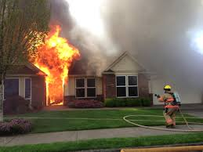
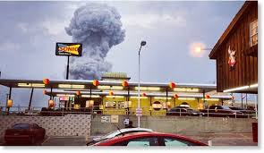
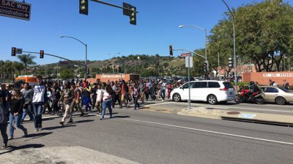
Faculty & Staff
Emergency Guide
Baylor Department of Public Safety
(254) 710-2222
Baylor.edu/emergency
Don’t:
Have “Tunnel Vision” during an incident.
Allow denial to slow your response.
Allow confusion.
Do:
Be Aware of your Surroundings.
Act Quickly
Take charge of students

Slide 2
Tornado Watch
Tornado Watch means that conditions are favorable for tornadoes to form.
Be alert to weather conditions and announcements.
Monitor weather reports/conditions.
Be prepared to seek shelter.
Tornado Warning
Tornado Warnings are indicated by radar or trained spotters. The McLennan County
Emergency Management Office issues tornado warnings and outdoor sirens will be sounded.
TAKE SHELTER!
Move to the lowest level.
Avoid windows, doors and outside walls.
Avoid any wide-span roof areas such as gymnasiums, cafeterias and large hallways.
Continue to monitor weather reports/conditions via mobile device, weather radio, etc.
Shelter map link: https://bayloru.maps.arcgis.com/apps/MapSeries/index.html?appid=0197bab3c6834f5595a0dfcc229b8781
All Clear
Upon hearing the All Clear, report any damage you observe to Facility Services.

Slide 3
During a flood
Listen to a battery-powered radio for emergency information.
Evacuate as instructed by emergency personnel.
During an evacuation
If advised to evacuate, do so immediately.
Evacuation is much simpler and safer before floodwaters become too deep for ordinary vehicles to drive through.
Listen to a battery-powered radio for evacuation instructions.
Follow recommended evacuation routes – shortcuts may be blocked.
Leave early enough to avoid being marooned by flooded roads.

Slide 4
Fire
Pull the nearest fire alarm to evacuate the building. Leave the building immediately, or if you hear the fire alarm, leave the building immediately.
If possible, shut down any equipment or processes that could cause a secondary fire if left unattended.
Be prepared to use an alternate route if necessary. Do not use elevators. If you are trapped in the building, try to reach a point of refuge, such as an enclosed stairwell.
If possible, close doors and windows behind you on the way out to confine the fire.
Keep low to the ground if there is smoke.
On your way out, assist any mobility-impaired persons to an enclosed stairwell or other point of refuge if possible. Report their location to the emergency response personnel.
Once out of the building, assemble at the Evacuation Assembly Points.
Assembly point map: https://bayloru.maps.arcgis.com/apps/MapSeries/index.html?appid=0197bab3c6834f5595a0dfcc229b8781
Do not re-enter the building until either the Waco Fire Department or Baylor Police issues the All Clear.

Slide 5
Explosion
Evacuate, if safe, and pull the nearest fire alarm station to evacuate the building.
Dial (254) 710-2222 and advise Baylor Police Dispatch of the location of the explosion and, if known, its seriousness and any possible injuries to persons in the area. Be sure to give your name, location, and telephone number. Do not hang up until released by Dispatch.
Assemble at Emergency Assembly Point(s) outside the building until help arrives.
Advise emergency personnel about the explosion area and any person(s) you are aware of who may have been injured.

Slide 6
Evacuation
Always evacuate if the fire alarm sounds.
Close office/classroom doors and turn off lights and computers.
Use designated corridors and fire exit stairs that lead to the ground level.
Leave the building in an orderly manner.
Do not use elevators.
Assemble at the pre-designated Evacuation Assembly Point(s) (EAPs). EAPs will be used to provide occupants with information regarding the status of the building. "All Clear” announcements will be made at the EAPs.
Evacuation map link: https://bayloru.maps.arcgis.com/apps/MapSeries/index.html?appid=0197bab3c6834f5595a0dfcc229b8781
Report any individuals left in the building to emergency personnel and/or designated faculty/staff member(s).
Do not re-enter the building until an “All Clear” announcement is given by emergency personnel.

Slide 7
Shelter in Place
If you are inside, remain in the facility.
If you are outdoors, quickly proceeding into the closest building, or follow instructions from emergency personnel on the scene.
Locate a room to shelter inside. It should be an interior room, the lowest level, and without windows or with the least number of windows. If there is a large group of people inside a particular building, several rooms may be necessary.
Turn on a radio or TV and listen for emergency communication or further instructions.
Take refuge until an evacuation can be safely initiated or an “All Clear” is given.

Slide 8
BAYLORALERT!
EMERGENCY NOTIFICATION SYSTEM
Baylor Alert is Baylor University’s system for alerting students, staff and faculty in the event of an emergency or threat on campus. The following systems may be utilized to communicate emergency information and procedures to campus constituents:
Outdoor Mass Notification System (Main Campus Only)
Indoor Notification System (Main Campus Only)
Email notification to Baylor email account
Text message to cell phone or another phone
Audio message to a cell phone or other telephone
Official University websites (e.g., www.baylor.edu)
Official University social media accounts (Facebook: https://www.baylor.edu/facebook/; Twitter: @bayloralert and @baylor)
Baylor Information Line (254) 710-4411
University email distribution systems

Slide 9
Register for BAYLORALERT
Students, faculty and staff may enter or update contact information online:
Students: bearweb.baylor.edu
Instructions are available HERE
Parents can be added as an "alternate Baylor Alert contact" by their student using the instructions provided above.
Employees: baylor.edu/ignite
Parents, visitors, contractors and others can opt-in to receive Baylor Alert (text messages) using one of following options:
Short term visitors (1-3 days) can text Baylor1845 to 226787. *Note, subscriptions automatically expire after 3 days.
Long term visitors (weeks, months, semester, etc.) can text Baylor76798 to 226787. *Note, subscriptions do not automatically expire. Users need to opt-out to stop receiving notifications.

Slide 10
BAYLORALERT!
EMERGENCY NOTIFICATION SYSTEM - CONTINUED
All initial messages will provide a brief description of the emergency type. When additional information is available a text may be sent direct to students, staff and faculty with further instructions. The information you receive may caution you to avoid certain areas of the campus, let you know if classes are canceled due to an emergency, or provide vital information on what actions you need to take if you are on campus during such a situation.
Notifications are given to the entire community due to the size of the campus, the frequency of movement within the campus by community members, and the concept of keeping the entire community aware of significant emergencies.
Review your contact information in Bearweb by clicking on “View & Update cell phone information” and “View & Update Baylor Alert cell phone information.”
If you receive a Baylor Alert, please share the information immediately.

Slide 11
BU CAMPUS GUARDIAN
The BU Campus guardian Mobile Safety Application can turn your smartphone into a personal safety device! Quickly contact University Police in case of an emergency by phone call or text. Follow the link for additional information: https://www.baylor.edu/dps/index.php?id=973173
To Download the free BU Campus guardian App:
Go to you’re Apple App Store or Google Play Store and search for Rave Guardian
As part of the download, you will be asked to create a simple safety profile and enter your Baylor email. Provide as much information as possible when setting up your profile.
The final step is to reply to an email that will be sent to you by Rave Guardian, this will complete the configuration of the app of your mobile device.
Safety files for Faster Emergency Response
Your safety profile contains details such as your campus residence hall or office location, medical condition or other pertinent information. This information is automatically presented to the police dispatcher during an emergency call for paster, more precise response.
This data isn’t shared with police until activation occurs either by call, text or expired safety timer.
Emergency Call Buttons
Through your mobile device, a user can send an alert to the Baylor Police Communications Center with one-click, automatically providing the users information and GPS location.
If off campus you can call the local 911 call center with one button click.

Slide 12
Criminal Incident / Suspicious Activity
Contact Baylor Police (254) 710-2222.
Remember – when in doubt, give us a shout!
Be prepared to tell the dispatcher:
Your name
Your phone number
If the incident is still in progress
The exact location of the incident
The nature of the incident (Who, What, Where, When, and Why)
Best available description of any suspect(s)
If the suspect(s) are leaving or have left, their direction of travel and mode of travel, (by foot, bike or vehicle)
Location where the police officer can meet you
Stay on the line with the dispatcher until they release you.
For in-progress incidents, the dispatcher will keep you on the phone until the officer arrives.

Slide 13
Medical
Contact Baylor Police at (254) 710-2222 and tell the dispatcher that you require medical assistance. Be prepared to provide the following information:
Location
Type of injury
Number injured
Age and gender of the involved parties
Is injured conscious?
Is injured breathing?
Is injured bleeding?
Do not move the victim unless it is necessary to remove them from a dangerous location or situation.
Do not approach people who have been injured by electrocution or toxic exposure unless they are clearly away from the hazard.
Stay with the victim.
If trained, and have appropriate Personal Protective Equipment use pressure to stop the bleeding.
Use CPR/AED if there is no pulse and the victim is not breathing.

Slide 14
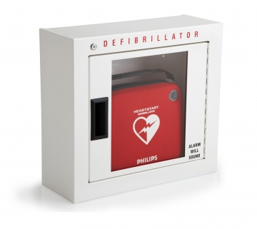
Medical
Throughout campus Automated External Defibrillators and Stop the Bleed Kits have been located for trained individuals to provide aid to someone in need, if they choose. Before any aid is rendered 911 or 710-2222 should be called so that emergency responders can be enroute. Contact the EHS Student Safety Manager with any questions about the kits or training that is offered.

Slide 15
Active Shooter
Training Links: Introduction link: Active Shooter Training: Introduction | Department of Public Safety | Baylor University
Active Shooter Training link Active Shooter Training | Department of Public Safety | Baylor University
Avoid|Deny|Defend
During an act of violence (e.g., robbery, hostage situation, workplace violence, active shooter):
AVOID starts with your state of mind.
Pay attention to your surroundings.
Have an exit plan.
Move away from the source of the threat as quickly as possible.
The more distance and barriers between you and the threat, the better.
DENY when getting away is difficult or maybe even impossible.
Keep distance between you and the source.
Create barriers to prevent or slow down a threat from getting to you.
Turn the lights off.
Remain out of sight and quiet by hiding behind large objects and silence your phone.
DEFEND because you have the right to protect yourself.
If you cannot Avoid or Deny, be prepared to defend yourself.
Be aggressive and committed to your actions.
Do not fight fairly. THIS IS ABOUT SURVIVAL.
CALL 911 or 254-710-2222
When Law Enforcement arrives, SHOW YOUR HANDS AND FOLLOW COMMANDS.

Slide 16
REFERENCE
The Baylor Department of Public Safety consists of the following:
Baylor Police
Emergency Management and Fire Safety
Technical Security
Parking and Transportation
Global Safety and Security
Crime Prevention
The Baylor Department of Public Safety has its own communication center where police dispatchers are available around the clock at (254) 710-2222.
The Baylor Police can be contacted directly from a campus phone at extension 2222 or 911.
Calling 911 on your cell phone will connect you with the Waco Police Dispatcher; they will transfer you to the Baylor PD dispatcher, thus delaying the emergency response.
Baylor police officers are licensed through the State of Texas and have the same legal authority as any municipal police officer. Baylor police are on duty year-round, 24 hours a day, and have the capability to respond to and investigate any type of criminal incident.
Crime prevention services are available for students, faculty and staff concerning personal safety and crime prevention assessment. Rev. 8 2021

