Slide 1
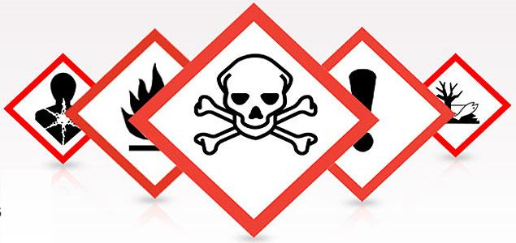
General Chemical Awareness For Office Personnel
Environmental Health & Safety
Baylor University

Slide 2
About this training
This presentation is designed to convey basic awareness of chemical hazard labeling to personnel who don’t handle chemicals, but work where they may occasionally be in areas containing chemicals.
At the end of the presentation, you will be given the opportunity to request a certificate of completion.

Slide 3
About this training
This presentation is interactive. You will be prompted throughout the presentation to answer questions or make decisions before you can advance:
This is a sample screen. Click the “Next” button to continue.

Slide 4
Why is Awareness Important?
There are regulations that cover personnel who work in labs, and personnel who work with hazardous chemicals outside of labs (for instance, maintenance workers), but personnel who work in offices are exempt from these regulations.
Nevertheless, you may have the occasion to be in a location where chemicals are stored or used, and you are certainly surrounded by locations where chemicals are stored and used, and therefore it is to your benefit to have an awareness of your surroundings.
This presentation will give you an overview of the means of communicating chemical hazards, so that you can be informed of the hazards that may be present around you.

Slide 5
This section of the presentation will tell you about the three chemical labeling systems that are currently in use, as well as inform you about the hazard information labeling on the rooms.
Press the “Chemical Labeling and Information Systems” button below to begin.

Slide 6
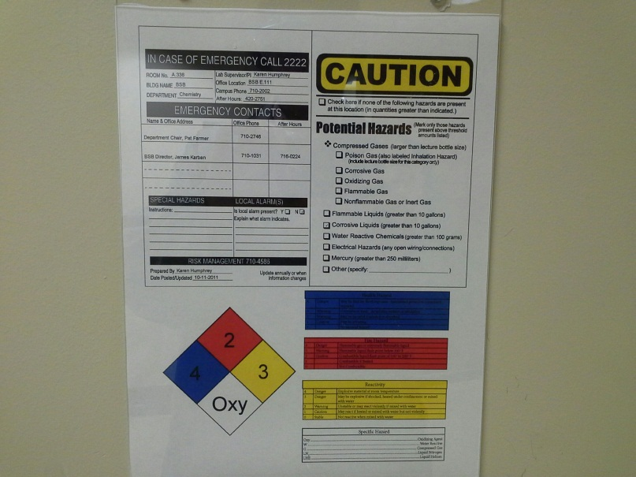
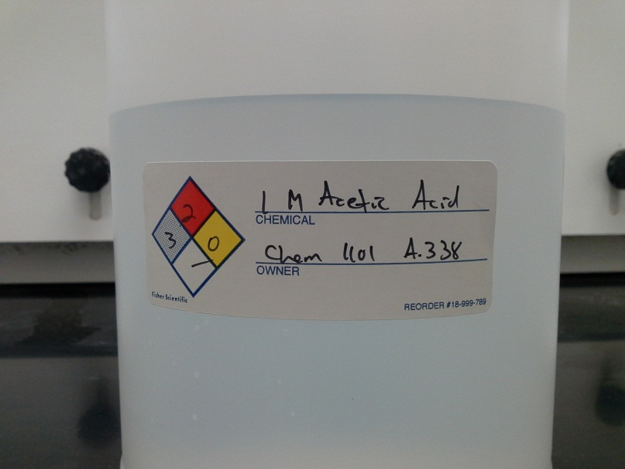
NFPA Diamonds
The National Fire Prevention Association developed this signage to indicate to first responders the level of hazard present in a location where chemicals are stored. The room’s rating is based on the highest hazard present in the location.
It is also used on chemical bottles to indicate, in one glance, the hazard ratings of that chemical.

Slide 7
NFPA Diamonds
Blue = Health
Red = Flammability
Yellow = Instability
White = Special hazard information
Notes:
National Fire Prevention Association

Slide 8
NFPA Diamonds
4= Deadly Hazard
3= Severe Hazard
2= Moderate Hazard
1= Slight Hazard
0= No Hazard

Slide 9
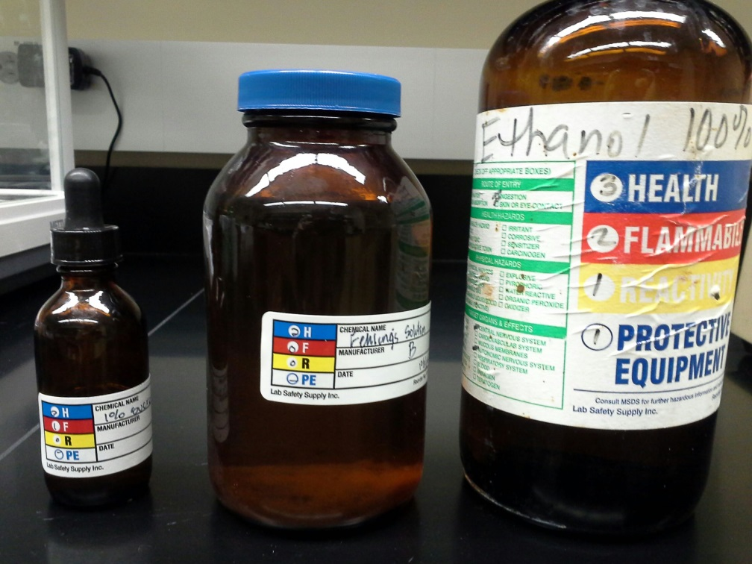
HMIS Labels
The Hazardous Materials Information System was developed by the American Coating Association as a compliance aid for the OSHA Hazard Communication Standard
Designed to go on individual containers of products that don’t have manufacturer’s labels
Same color code/numerical rating system as the NFPA diamonds
Notes:
Hazardous Materials Identification System

Slide 10
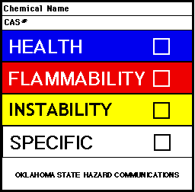
HMIS Labels
Blue = Health
Red = Flammability
Yellow = Instability
White = Special hazard information or protective equipment
Numerical Rating of 0-4
3
4
1
W

Slide 11
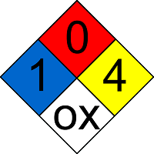
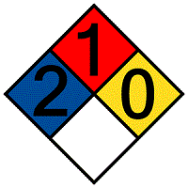
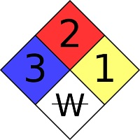
What do you think?
Which of these represents a chemical presenting a severe health hazard?

Slide 12
What do you think?
Which of these represents a chemical presenting a severe health hazard?
This represents a slight health hazard, a moderate flammability, a deadly reactivity, and an incompatibility with water.

Slide 13
What do you think?
Which of these represents a chemical presenting a severe health hazard?
This represents a slight health hazard, no flammability, a deadly reactivity, and that it is an oxidizer.

Slide 14
What do you think?
Which of these represents a chemical presenting a severe health hazard?
This represents a moderate health hazard, a slight flammability, and no reactivity

Slide 15
What do you think?
Which of these represents a chemical presenting a severe health hazard?
Correct! This diamond indicates that the chemical poses a severe health hazard. In addition, it also indicates a moderate flammability, a slight reactivity, and that the chemical is water reactive.

Slide 16
Globally Harmonized System (GHS)
In May of 2012, a revision of the 1994 Hazard Communication Standard (OSHA HazCom) went into effect. Commonly referred to as HazCom 2012, these revisions align the standard with the United Nations Globally Harmonized System (GHS) of Classification and Labeling of Chemicals.
The GHS is a system designed to standardize the information on hazardous chemicals internationally. The purpose of the GHS is to create a logical, comprehensive, and standardized system to communicate information about chemical hazards to workers, employers, consumers, emergency responders, transporters, and anyone who might come in contact with these chemicals worldwide.
Companies are phasing in this system and full implementation will be completed by June of 2016.

Slide 17
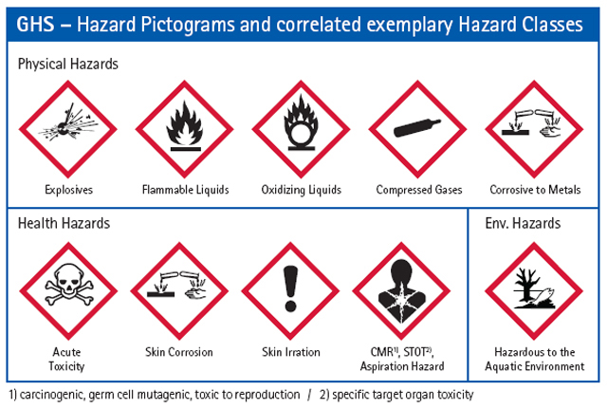
Globally Harmonized System (GHS)

Slide 18
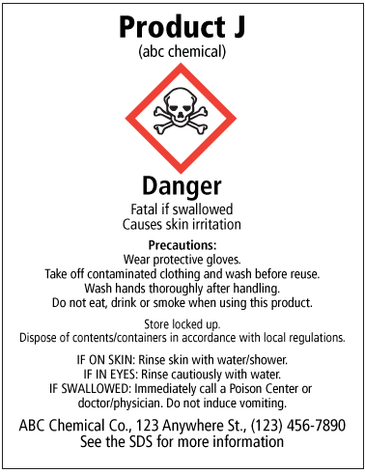
Globally Harmonized System (GHS)
Product
Identifier
Hazard
Pictogram(s)
Signal Word
Hazard
Statement(s)
Precautionary
Statement
Supplier
identifier

Slide 19
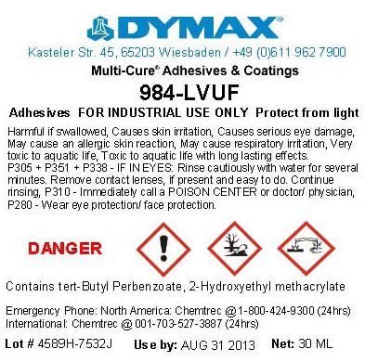
Globally Harmonized System (GHS)
An example of an actual chemical label using the new GHS system.

Slide 20
What do you think?
Which pictogram represents a substance that is acutely toxic?

Slide 21
What do you think?
Which pictogram represents a substance that is acutely toxic?
This represents a substance that is explosive.

Slide 22
What do you think?
Which pictogram represents a substance that is acutely toxic?
This pictogram represents a compressed gas.

Slide 23
What do you think?
Which pictogram represents a substance that is acutely toxic?
This represents a substance that causes cancer, is a reproductive toxin, or that has a target organ effect.

Slide 24
What do you think?
Which pictogram represents a substance that is acutely toxic?
Correct!
This pictogram represents a substance that is acutely toxic.

Slide 25
Hazard Information for Rooms
The NFPA diamond is commonly encountered when dealing with chemical storage locations such as the chemical storerooms, flammables cabinets, and other chemical storage cabinets.
The diamond will be posted on the room or cabinet door and will be based on the highest hazard present in that location.
An example is given on the next screen.

Slide 26
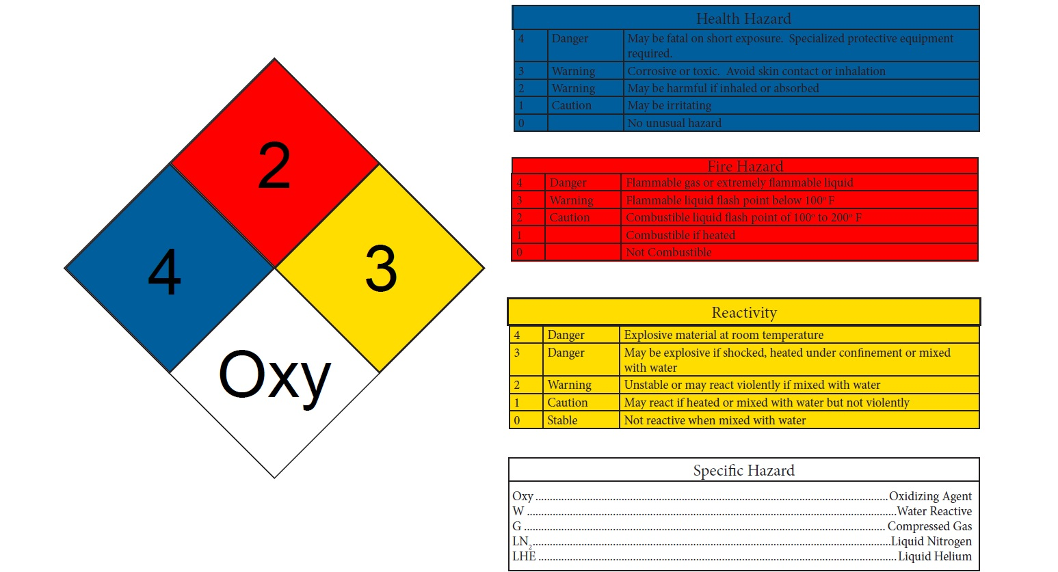
Hazard Information for Rooms

Slide 27
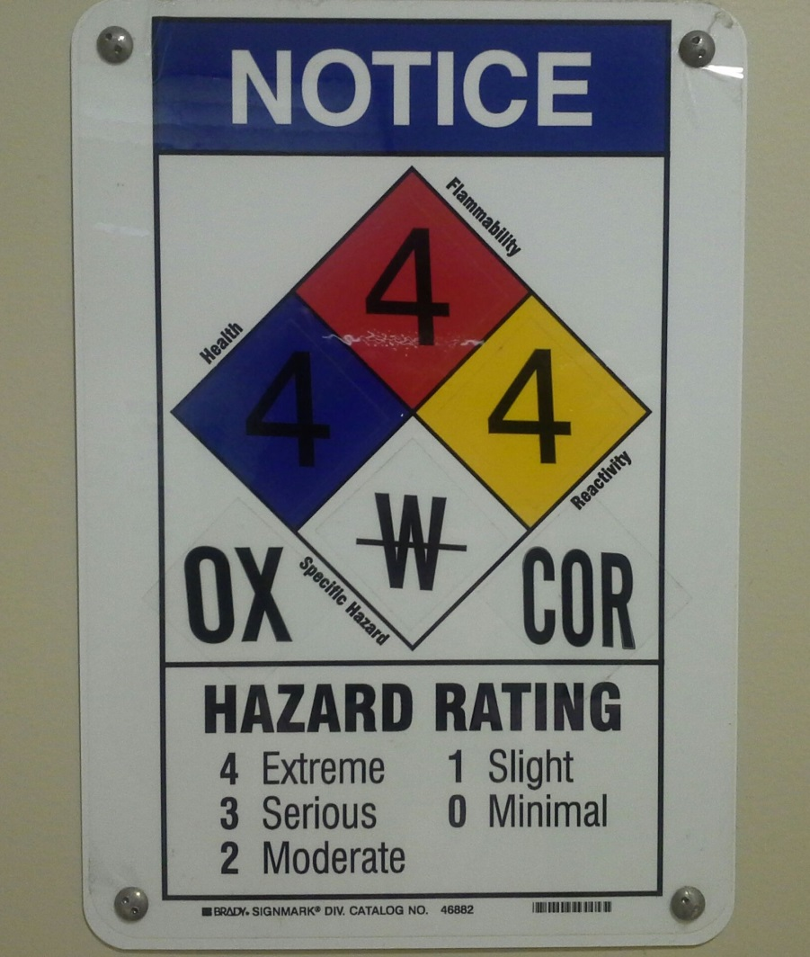
Hazard Information for Rooms
This is an actual posting outside a chemical store room in the Sciences Building.

Slide 28
Hazard Information for Rooms
Laboratories can have upwards of hundreds to thousands of different chemicals, and all scattered throughout the lab. Because the NFPA diamond is based on the highest hazard of the location, without regard to amount of the chemical present, it was felt to be an inaccurate snapshot of the hazards present in a lab.
For this reason, a more detailed representation of laboratory hazards was designed and implemented at Baylor in the fall of 2013. It uses the GHS pictograms to show what hazard categories are located where in a lab.
An example is given on the next two screens.

Slide 29
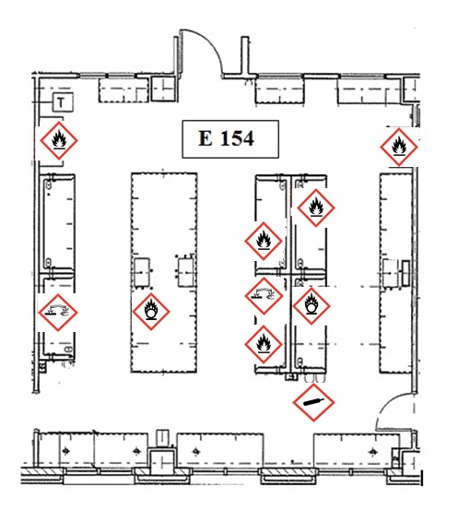
Hazard Information for Rooms
A theoretical example of what such a map would look like. The map is on the top part of the page.

Slide 30
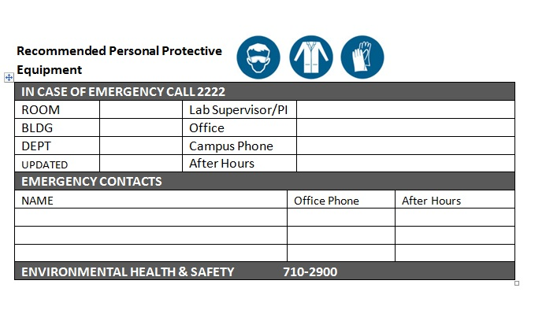
Hazard Information for Rooms
The bottom half of the page contains additional information.

Slide 31
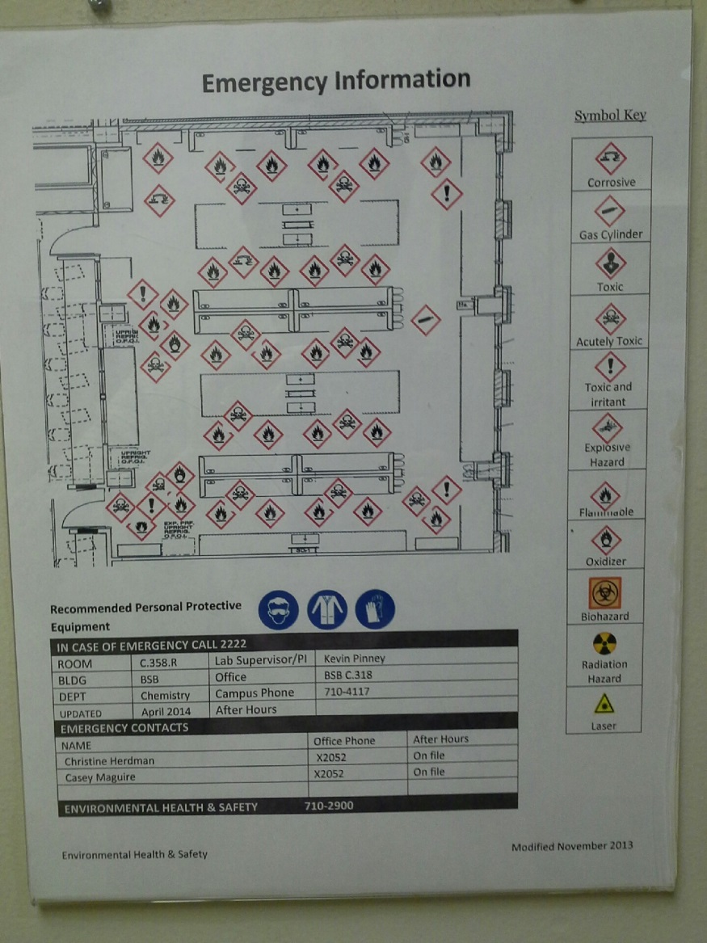
Hazard Information for Rooms
This is an actual posting outside one of the labs in the Sciences Building.

Slide 32
Section Complete!
Congratulations, you have completed the section on recognizing hazards and you should now be familiar with the signage and labeling that is common to rooms and chemical containers.
You are now ready to advance to the next section of the presentation.

Slide 33
This section of the presentation will tell you about the types of emergencies that may happen in areas where chemicals are stored and used, and how to properly respond to them.
Press the “Chemical Incident Response” button below to begin.

Slide 34
Accidental Chemical Release
Spills of chemical material are the most likely incident to occur in areas where chemicals are stored and/or used. Simply put, a spill is a chemical that is out of the control of the user. Whether it’s a few drops, a few crystals, or a 2.5 L container of an acid, the result is the same: a chemical out of control. The only question is the quantity and the identity of the material. Both will dictate, in large part, the response effort that is directed at cleaning up the spill.
There is no hard and fast rule on what constitutes a large spill versus a small spill. This depends on the properties of the material (flammability, toxicity, etc.) and the experience of the person(s) responding to the spill. A spill of 100 mL a dilute acid will be much different than a spill of 100 mL of mercury.
If there is a spill in an area, the personnel in the area will attend to it or will evacuate the area so that professionals can respond to the spill.

Slide 35
Accidental Chemical Release
In the unlikely event that a chemical release is reported to you, do the following:
First, find out if anyone is attending to it;
If not, treat it as an emergency and call Baylor Police at 710-2222.
In the even more unlikely event that you are in a room where a chemical release has occurred, leave the room immediately and let the personnel present attend to the spill. Do not attempt to help them clean it up, as you likely will not know the properties of the substance released and will not have the proper personal protective equipment to don while cleaning up the spill. You may, if requested, contact additional personnel to assist.

Slide 36
Chemical Exposure
There are four ways in which a person may be exposed to a chemical:
Ingestion: the chemical enters through the mouth and digestive tract.
Inhalation: the chemical enters through the nose and respiratory tract.
Skin contact: this can include surface dermal exposure as well as absorption through the skin and into the bloodstream.
Injection: the chemical enters directly into the bloodstream through a needle or other sharp object (such as broken glass).
Most of these require direct contact with a chemical. The exception is inhalation, which may affect a larger area in the event of an accidental release.

Slide 37
Chemical Exposure
There are many signs and symptoms associated with a chemical exposure due to inhalation. Some signs of inhalation exposure can include, but are not limited to:
Strange smells and/or tastes
Headache
Dizziness
Nausea
Fatigue

Slide 38
Chemical Exposure
Medical evaluations and/or exposure monitoring will be arranged by EH&S whenever exposure to a hazardous chemical has or may have taken place. Examples of such instances include:
In the event of an incident where there is a likelihood that an exposure has occurred, such as a spill or leak.
When personnel develop signs or symptoms that indicate a possible exposure.
When requested by personnel.
All exposed personnel will be provided an opportunity to receive medical attention from a licensed physician.

Slide 39
Fires
Small fires in an area may be able to be extinguished by the personnel present. In the event of a fire that cannot be readily extinguished by persons on site, the best course of action is to evacuate and pull the fire alarm.
If you are evacuating, remember the following:
Don’t panic.
Evacuate the building via the closest exit door. Do not use elevators.
Assist disabled individuals to the nearest stairwell landing and advise the responders of their location.
Evacuate the building and move to the pre-designated evacuation assembly point.

Slide 40
Other Emergencies
In addition to the types of emergencies already mentioned in this training, you may also run into the same types of medical emergencies you might encounter anywhere, such as:
Soft-tissue injuries
Thermal burns
Sudden illness
If you wish to become certified in CPR and/or first aid, there are classes offered on campus and elsewhere in the community.
Remember, in an emergency, call the Baylor Police Department at 710-2222.

Slide 41
What do you think?
At any point that you feel an incident is in need of immediate emergency assistance, you should contact the Baylor DPS at 710-2222.

Slide 42
What do you think?
At any point that you feel an incident is in need of immediate emergency assistance, you should contact the Baylor DPS at 710-2222.
The Baylor DPS serves as the emergency dispatch for the campus.

Slide 43
What do you think?
At any point that you feel an incident is in need of immediate emergency assistance, you should contact the Baylor DPS at 710-2222.
Correct. Baylor DPS can dispatch emergency responders to the campus and can guide them to the correct location.

Slide 44
Questions?
If you have any questions regarding this chemical awareness presentation or the information contained therein, please contact:
Karalyn (Karen) Humphrey
Chemical Hygiene Officer
Phone: 710-2002
Email: Karalyn_Humphrey@baylor.edu

Slide 45
Presentation Complete
You have now completed the Basic Chemical Awareness presentation.
If you need/want a certificate of completion, please email Karalyn_Humphrey@baylor.edu.
Please press “esc” to end this presentation.

